Slide 1
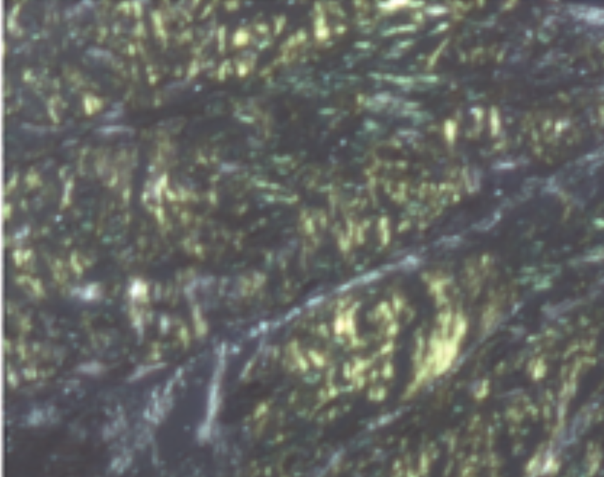
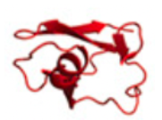
Full length subunit
Dissociation
Fibrils formation
49–127 TTR
Cleavage and dissociation
1–48 TTR
Unfolding forces

